Slide 1
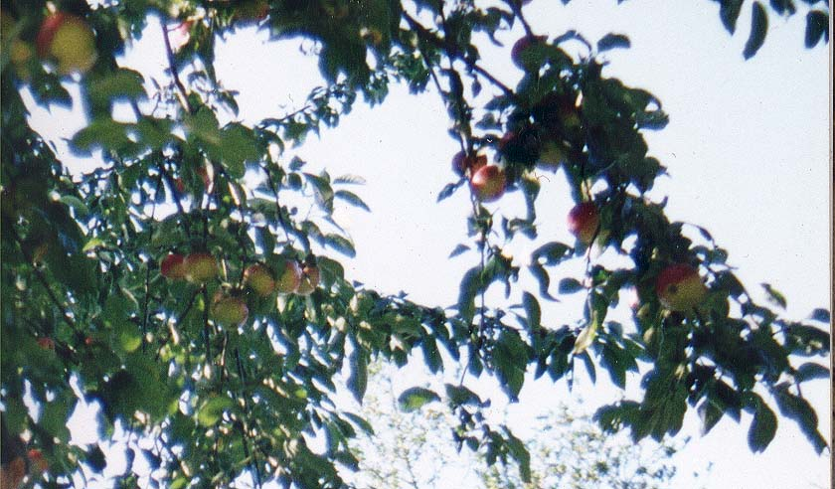
Ancient Greek Food
Food, for the Greeks, had all sorts of religious and philosophical meaning.

Slide 2
The Greeks, to begin with, never ate meat unless it had been sacrificed to a god, or had been hunted in the wild.

Slide 3
Even with vegetables, many Greeks believed that particular foods were cleaner or dirtier, or that certain gods liked certain foods better than others.

Slide 4
The Greeks ate mainly the Mediterranean triad, wheat (or barley or millet), wine, and olive oil.

Slide 5
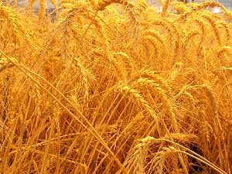
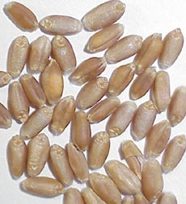
Wheat

Slide 6
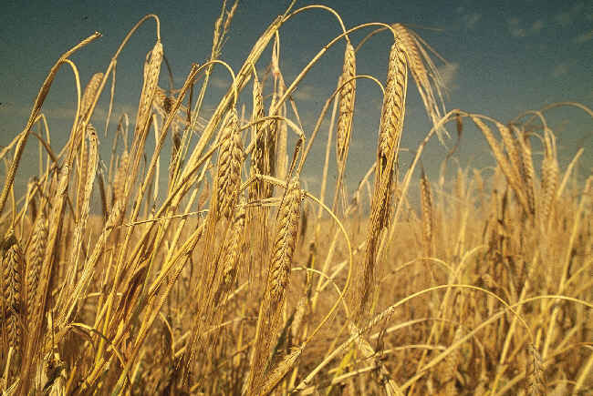
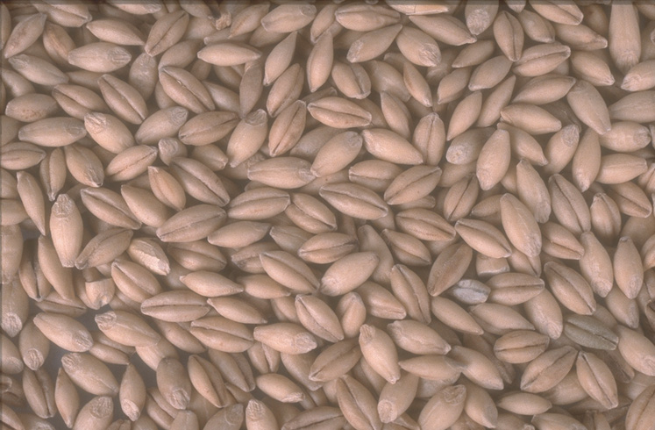
Barley

Slide 7
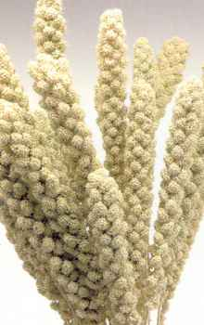
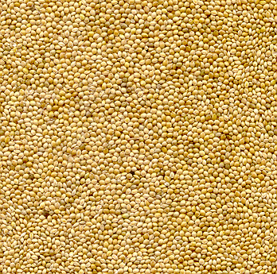
Millet

Slide 8
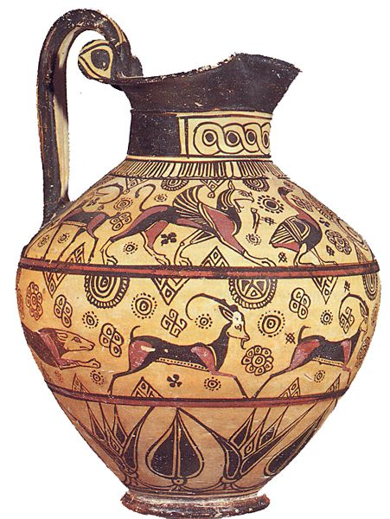
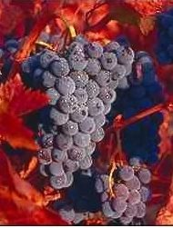
Wine

Slide 9
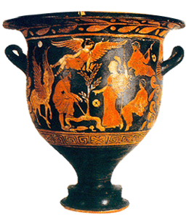
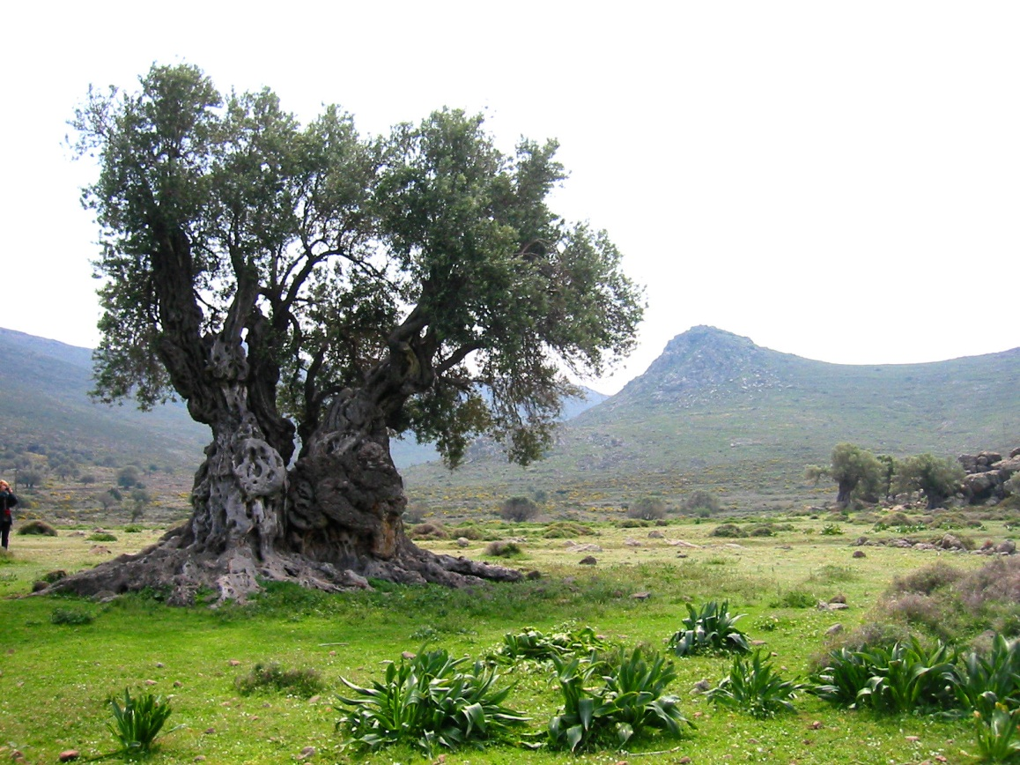
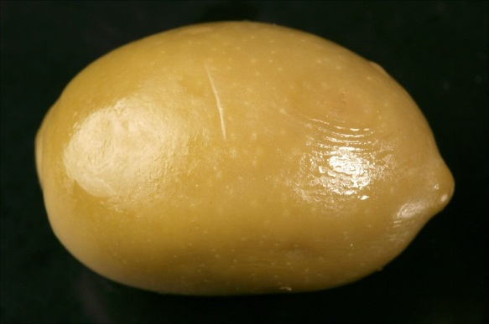
Olive Oil

Slide 10
They also grew vegetables, especially legumes (lentils, beans, peas, chickpeas).

Slide 11
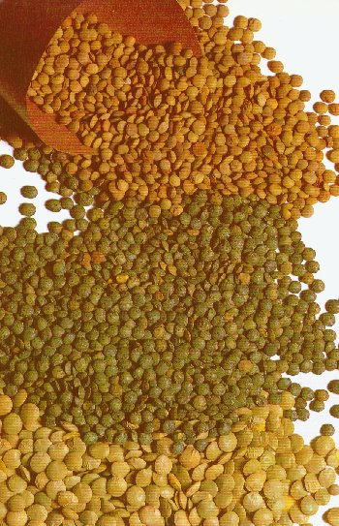
Lentils

Slide 12
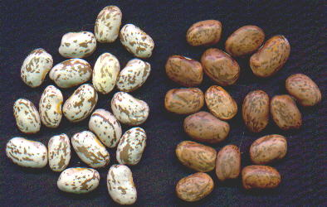
Beans

Slide 13
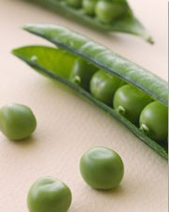
Peas

Slide 14
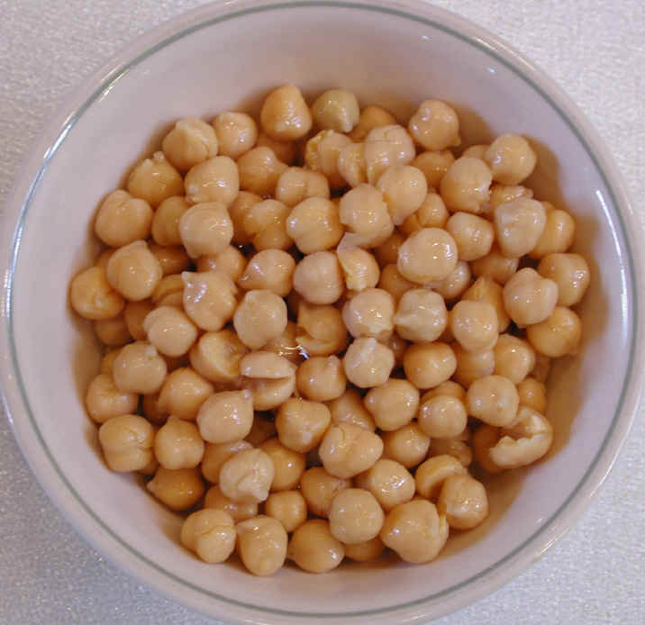
Chick
Peas

Slide 15
Possibly they ate more fish than most other Mediterranean people.

Slide 16
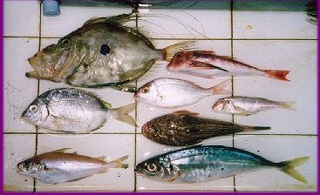
Fish

Slide 17
Also, because of their feelings about sacrificing meat, they may have eaten meat less than other people did.

Slide 18
Food in Ancient Greece
Olives, grapes and figs grew along the coast.
Wheat was grown on the plains.
Lentils, beans and chickpeas were also grown.

Slide 19
Food in Ancient Greece
Olives, grapes and figs grew along the coast.
Wheat was grown on the plains.
Lentils, beans and chickpeas were also grown.

