Slide 1
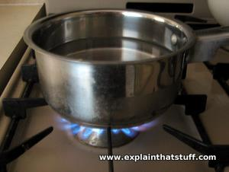
Saucepan - It allows heat to travel through the metal to the food. - It does not melt on the cooker.

Slide 2
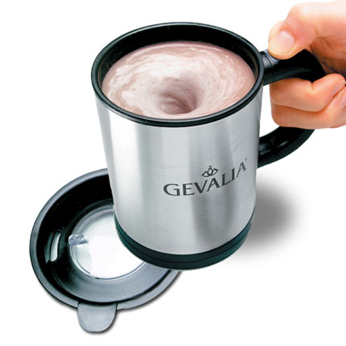
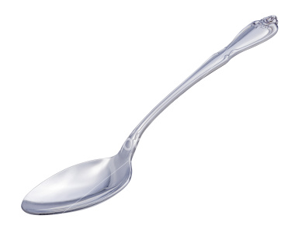
Metal spoon - It does not melt in hot liquids. - It does not stain easily. - It does not break easily.

Slide 3
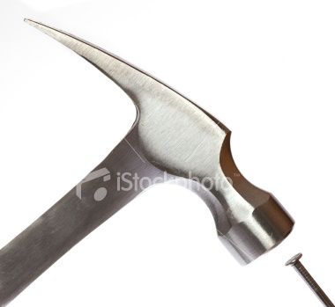
Nail - It is strong. - It can be made sharp.

